Slide 1
Data Design
Week 2, Business processes

Slide 2
Today’s lesson
Processes
Throughput
Bottlenecks
Added value
Value chain

Slide 3
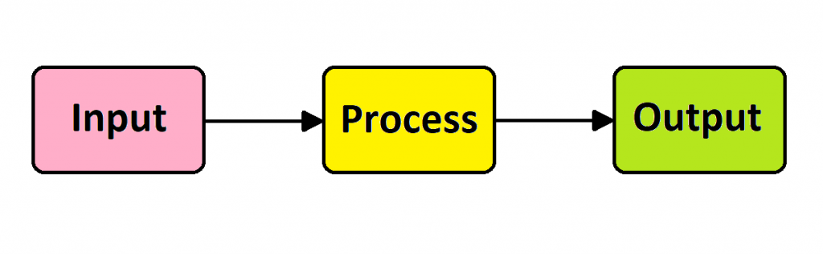
Basic process

Slide 4
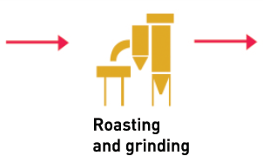
Example
Raw green coffee beans
Roasted coffee beans

Slide 5
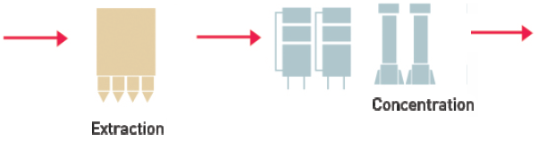
Output from one process can be the input for another
Roasted coffee beans
Coffee concentrate

Slide 6
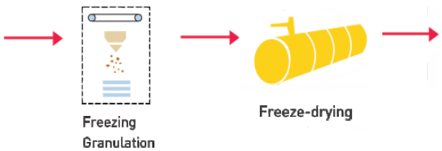
And another
Coffee concentrate
Freeze-dried coffee

Slide 7
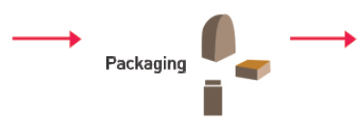
And another
Freeze-dried coffee
Your coffee product in the shop

Slide 8
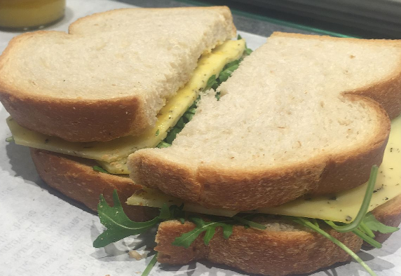
Exercise
Draw the process of making a sandwich

Slide 9
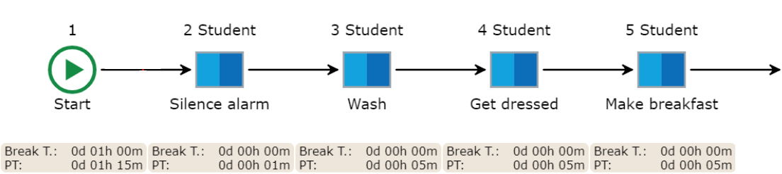
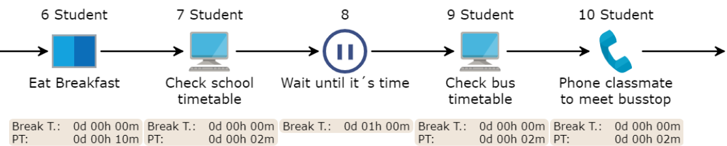
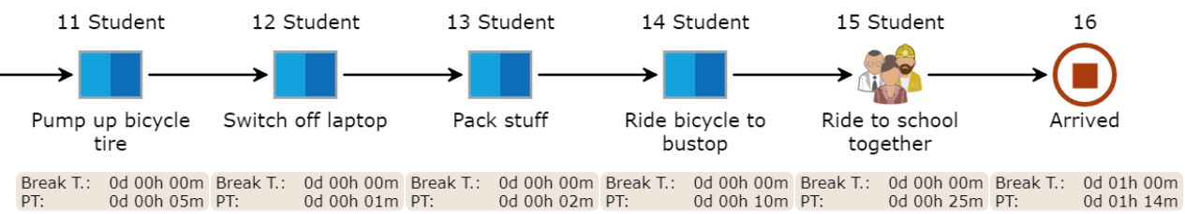
Notes:
Discuss with the class:
1. What do you do if something fails? For example, the bus is late.
2. But also things that can be done in parallel or in a different order.
4. Risks? (missing the bus)
5. IST and SOLL, so where are you now and where do you want to go
6. Do all steps also add something relevant? (lean)
7. The organizational environment is the sphere of influence in which your process is present. This way you cannot adjust the bus times, but you do interact with them.
8. Not every step has to add value. If you first want to play angry birds, that does not add value, but it is part of the process.

Slide 10
From this to that
Means you`re going to change the process to improve throughput time or effectiveness.
Analyse the process, find bottlenecks and unwanted effects.
Propose a new, improved process.

Slide 11
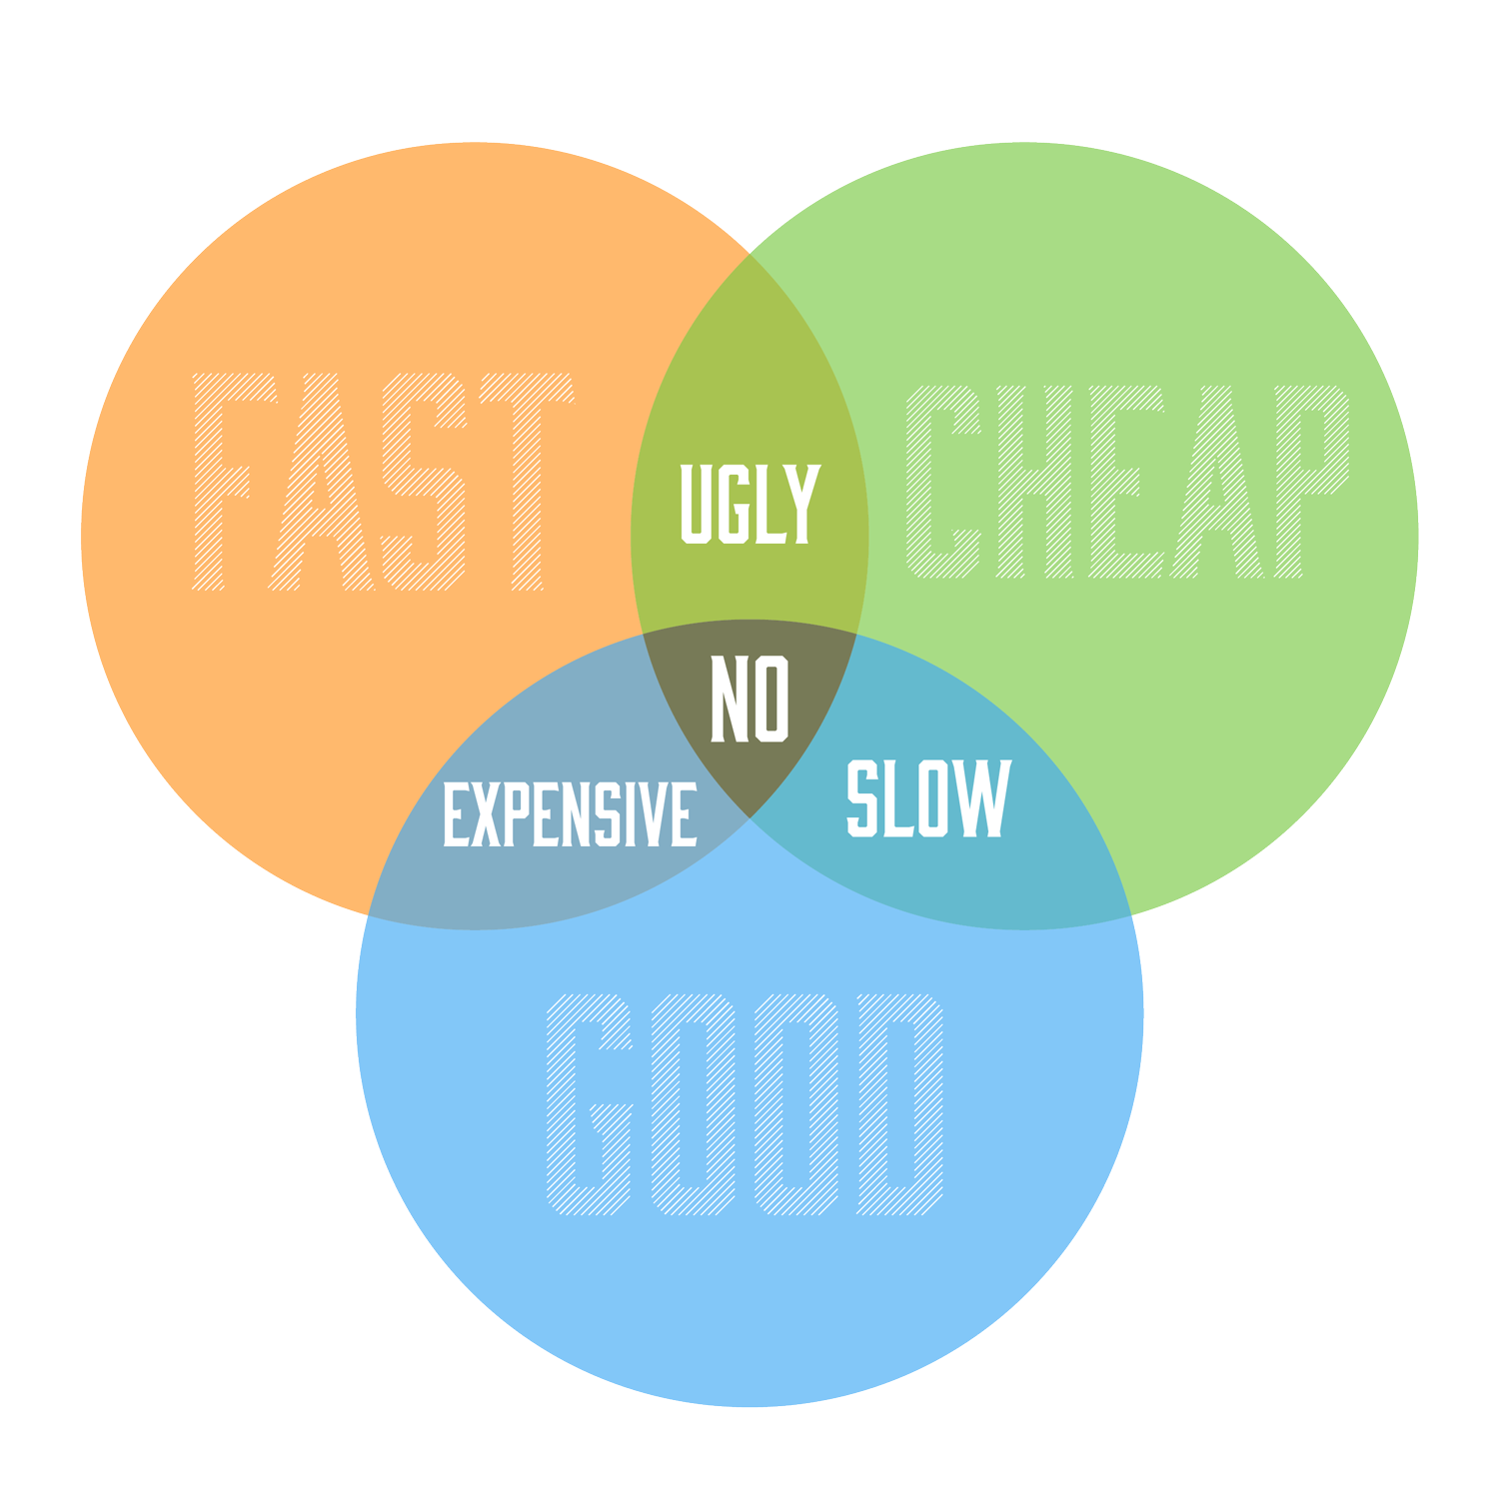
devil's triangle
Do you want a quick breakfast (not very delicious)
Do you want a delicious breakfast (not very quick)
Do you want a quick, delicious breakfast (you`ll have to buy it and pay for it)

Slide 12
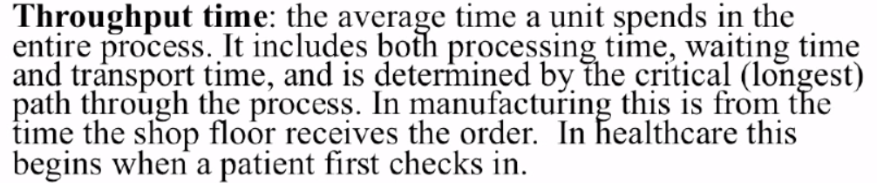
Throughput time

Slide 13
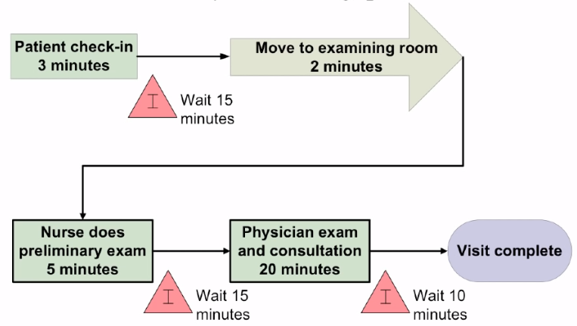
What is the throughput time?

Slide 14
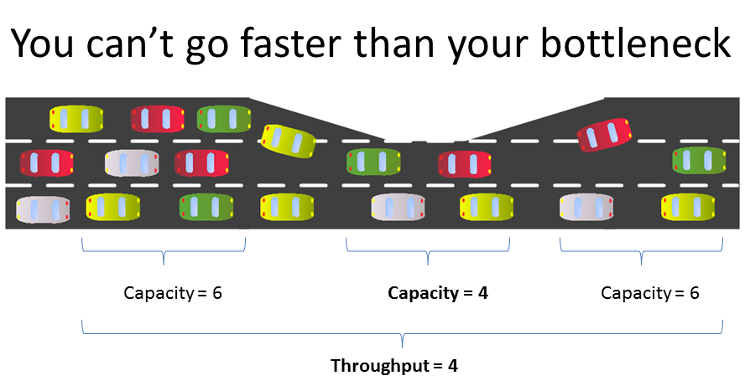
Bottleneck
Where are the bottlenecks in the process

Slide 15
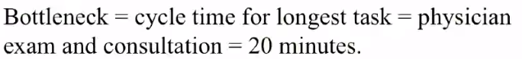
Bottleneck
Process step that is essential but takes the longest time
What is the bottleneck here?

Slide 16
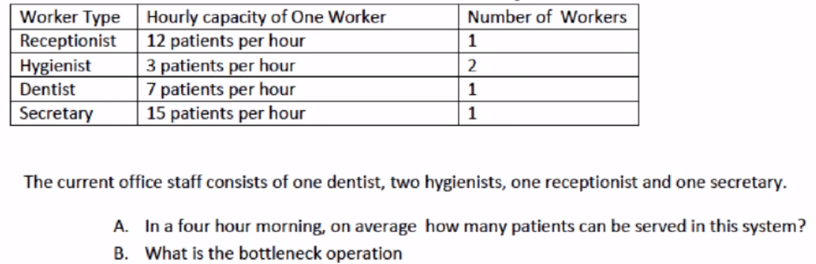
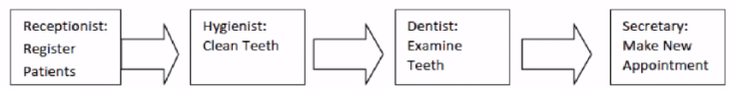
Bottleneck Example

Slide 17
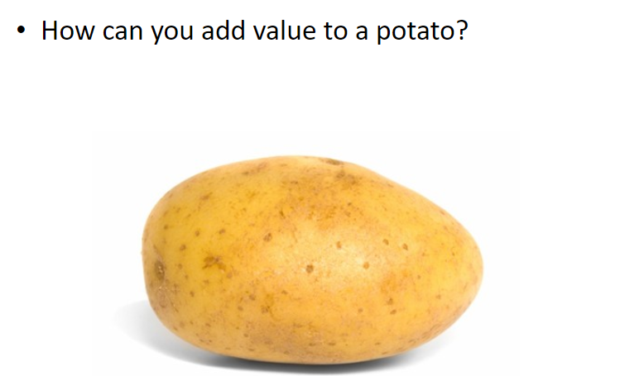
Adding Value

Slide 18
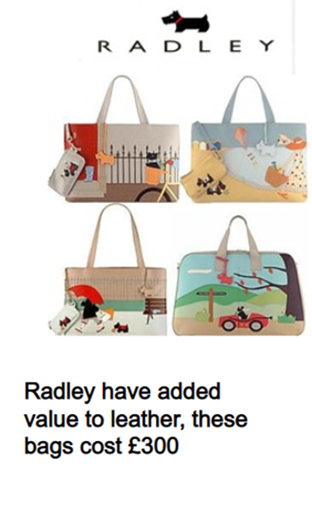
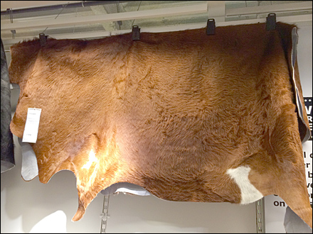
Benefits of adding value
becomes
Cheap raw leather

Slide 19
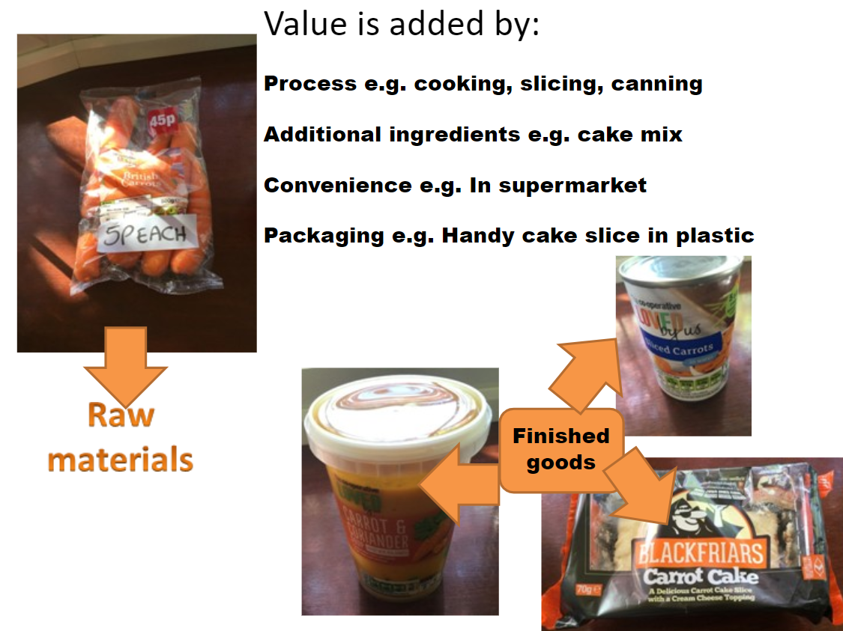
Added value

Slide 20
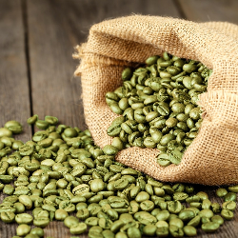
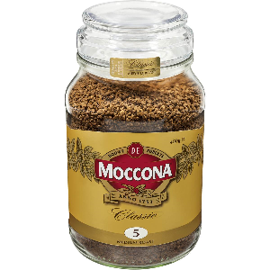
Value chain
Every process step adds value
For which product would you pay more per kg? Raw green coffee beans or finished product?
Why? What is the added value?

Slide 21
Value chain
A value chain is a set of activities that a firm operating in a specific industry performs in order to deliver a valuable product or service for the market.
https://www.youtube.com/watch?v=g8p2H7EvoGM

Slide 22
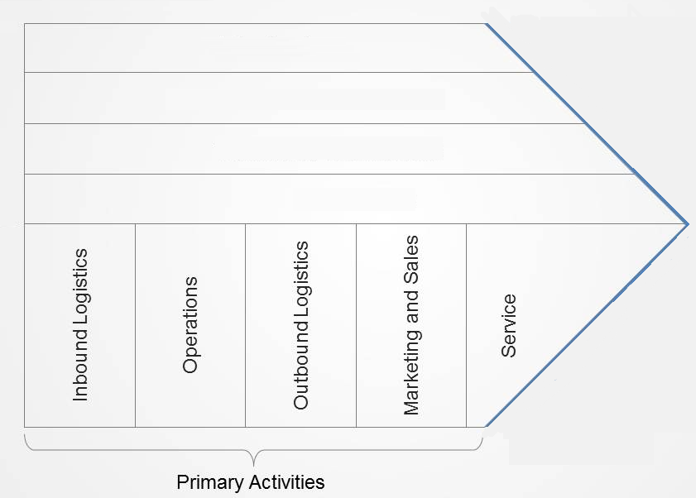
Value chain
Notes:
Inbound logistics: receiving and warehousing of raw material or goods coming into the business
Outbound logistics refers to the same for goods going out of a business
Operations can convert the inputs in the desired product. Examples: machining, packaging, assembly, equipment maintenance, testing, printing and facility operations.
Marketing and sales Examples: advertising, promotion, sales force, quoting, channel selection, channel relations and pricing
Service Examples: installation, repair, training, parts supply and product adjustment.

Slide 23
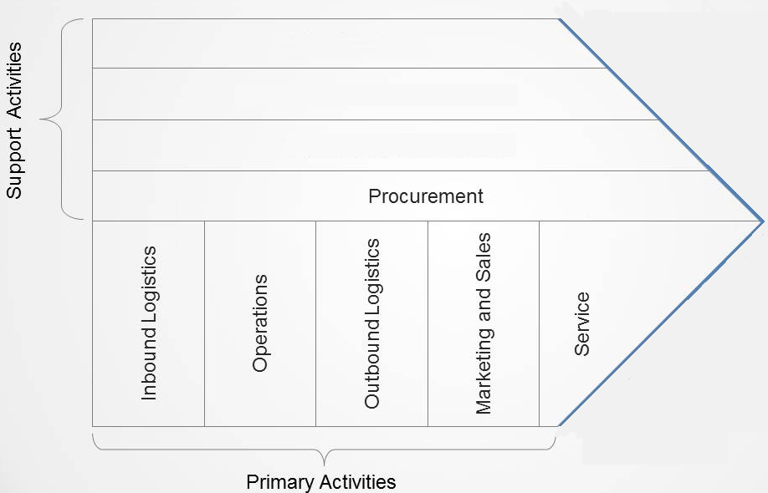
Value Chain
Notes:
Procurement machinery, laboratory equipment, office equipment and buildings

Slide 24
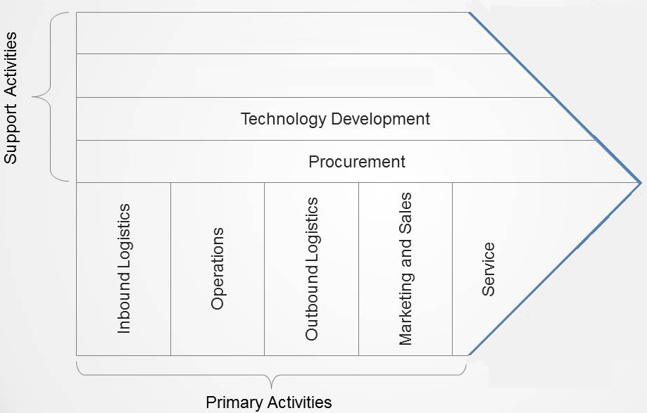
Value Chain
Notes:
Technology Development (R&D) efforts to improve the product and the process

Slide 25
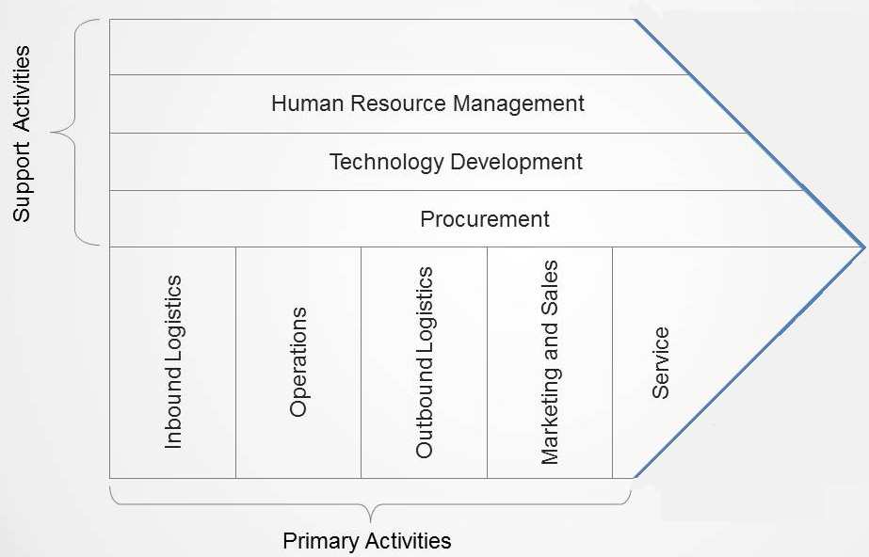
Value Chain
Notes:
HRM consists of activities involved in the recruiting, hiring (and firing), training, development and compensation of all types of personnel.

Slide 26
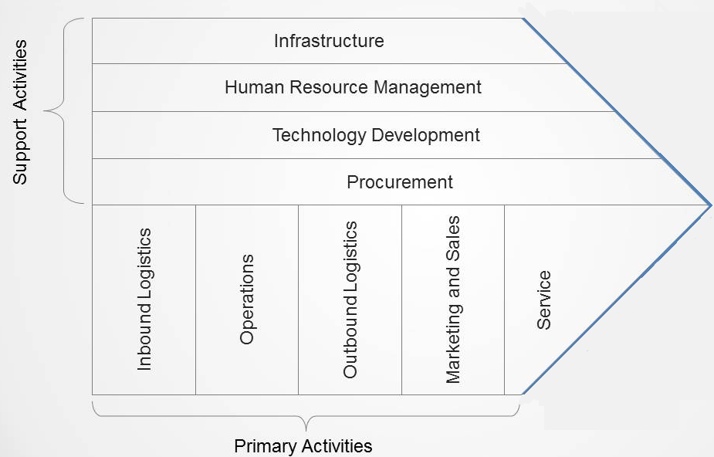
Value Chain
Notes:
Firm infrastructure consists of a number of activities including general (strategic) management, planning, finance, accounting, legal, government affairs and quality management.

Slide 27
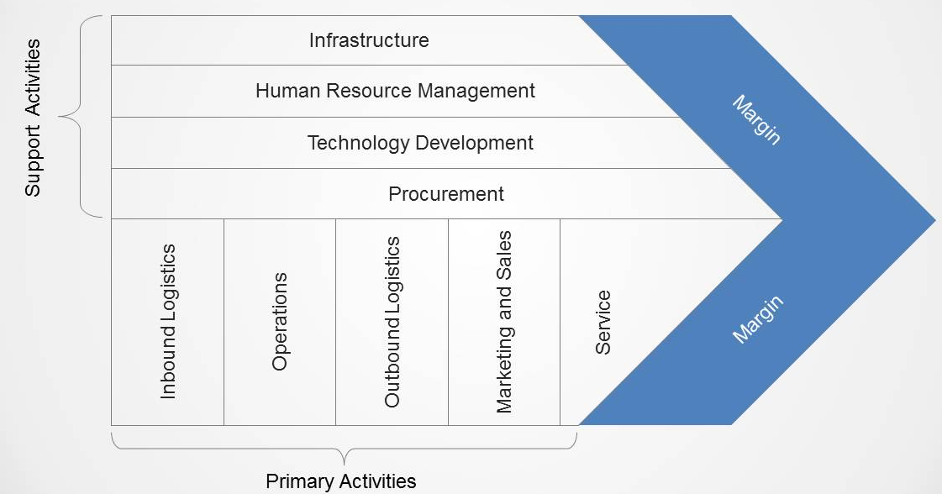
Value Chain
Notes:
Margin is profits

Slide 28
Exercise value chain
Fen Side Golf Course is an internationally known Scottish golf facility. It is not just an eighteen hole world-class golf course, it has a five star hotel with 250 luxury rooms, and private leisure centre, indoor tennis courts, as well as a series of top class restaurants.
A. All staff are trained to the highest industry standards.
B. The hotel management team focus on goals set out in their strategic plan.
C. All golf course fairways are trimmed and watered daily.
D. Fresh fruit and vegetables are delivered and prepared every day.
E. The hotel has an advanced room reservation system.
F. Fen Side is promoted through magazines targeted at the wealthy and influential.
G. The whole experience is based upon high quality, professional service at every stage.
H. Limousines are available to take guests to airports as they finish their stay.
I. Fen Side has a series of contracts with suppliers of meat and fish.
Notes:
These are a series of nine activities that add value to the Fen Side experience
place the appropriate letter onto the value chain.

